Slide 1
Introduction Shanmugakumar Manoharan
Oct| 2023

Slide 2
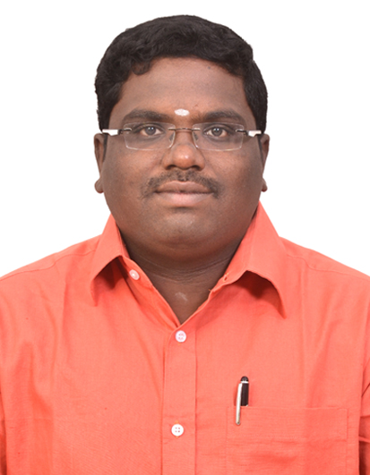
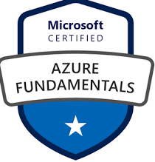
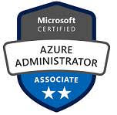


Overall Profile
Total Experience : 16 Years.
Technical Expertise:
Cloud Infra Arch and DevSecOps Specialist
Azure & AWS Infra Arch and E2E Design.
Managed Kubernetes (AKS,GKE)
Azure DevOps
Programming Skills
Release Management & Configuration Management
Photo
SHANMUGAKUMAR MANOHARAN
Cloud
SHAN is the Cloud Solution Arch and DevSecOps Engineer involved in BoA related Lead and DevSecOps Implementation and Advisory.

Slide 3
Success Stories and Credentials in CDE Team

Slide 4





2023 Value Delivered As Of Now..
MAJOR HIGHLIGHTS
Cloud Design Implementation Using Various Azure & AWS Services.
Express Route, VNET, VPC, Load Balancer, ELB and etc.,
Azure Front Door, AppGateway, Global Translator etc.,
Azure Virtual machines, EC2 Instance, EKS & GKE.
DevSecOps & IaC Implementation
Azure DevOps Implementation for AKS Based Apps
Azure DevOps for IaC
Process Implementation
Cloud Mature Team Formalization
Agile Process implementation for IaC team

Slide 5

2021 Value Delivered As Of Now..
MAJOR HIGHLIGHTS
Cloud Migration 40 + servers using Lift and Shift from On prim.
Cloud Automation ,sprint deliverables as part of IaC
Cloud and BAU Support Activities for various AI related projects.
PAAS POC’s for .NET Technical stack apps.
AKS for .NET Core
App Services for .NET Frameworks.
Cloud Automation Using Ansible
Azure Dashboard enablement for Various Infra Monitoring.
Continuously doing the new Cloud Modernization works for Client and sharing all the latest Trends to our Practise team regularly.
cloud and DevSeopc related sessions and mentorship to our team.
AKS Implementation
Cloud Automation

Slide 6
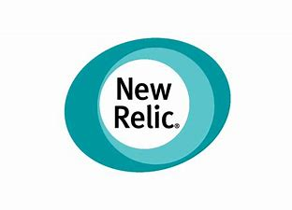


2022 Value Delivered As Of Now..
MAJOR HIGHLIGHTS
Cloud Solutions and Design of Various Cloud Providers like Azure and AWS.
E2E Cloud Design using Express Route and VPN Technologies.
Centralized Monitoring Implementation using NewRelic.
Cloud Maturity Model Design and implementing the POD Modeling
Centralized Cost Control Orchestration using Apptio.
AKS Implementation
Cloud Automation

Slide 7


2020 Value Delivered
MAJOR HIGHLIGHTS
Successfully Migrated the First Enterprise wide Cloud native app to production using Azure Kubernetes service. The Same solution design and best practises are shared to our practise. This activity was highly Appreciated by Client and SBU heads.
Key contributor for the vHealth Thailand Mobile Application, The End to End Infra solution and setup was done by myself, This is one of award winning app in 2020.
Key Contributor to the Cloud Automation(AKS) Using Ansible for a robust and reliable e2e Cloud infra deliverables. Along with CVS Pharmacy SDI Method of Automations.
Successfully Migrated 700 + Servers from On prim to Azure Using Lift and Shift, Played the Major Role for Cloud Specialist in Azure.
Continuously doing the new Cloud Modernization works for Client and sharing all the latest Trends to our Practise team regularly.
proposal related key contributions for Cognizant Projects and various teams. As well conducting major cloud and DevSeopc related sessions and mentorship to our team.
AKS Implementation
Cloud Automation

Slide 8
2019 Value Delivered
MAJOR HIGHLIGHTS
Successfully Piloted and show the Demo to Customer for the Azure DevOps for MS Dynamics Implementation.
Key contributor to the Server build Automation with Azure Cloud environments using Ansible for a robust & reliable end to end Infra automation process.
hAeta complete Cloud Team Management and mentor the team to spinup, Managing the 5+ Team for Cloud and DevSecOps Both Client and Cognizant side.
Providing continuous training/orientation programs/workshops to internal development and infrastructure teams to upskill the teams on new cloud & DevSecOps principles and processes.
Advisory to project team to enable the alignment to proper change management process and Ensuring security considerations and testing (code etc.) during application development.

Slide 9




2018 -17 Value Delivered
MAJOR HIGHLIGHTS
Successfully implemented the Ansible Tower for Infra E2E Automation for VM Provision and Join the domains and Integrated lot of Script Automation using the Ansible with help of YAML.
Implemented lot of Power Shell scripts for Azure Cost Optimization and reduce the manual work and improve the productivity and trained lot of resources.
During 2017 and initial 2018 ,Key Contribution in Trafigura Has performed well in Release management and DevOps Areas. Has improved in respective process areas. Has involved in CAST and brought in good practices in Release Management. Contribution towards corporate demands need mention. Need to contribute towards innovation in the team. Should address all communication objectively and should bring harmony.

Slide 10
Thanks !!!!!!

